Slide 1

CS144 An Introduction to Computer Networks
Packet Switching
Playback Buffers
Nick McKeown
Professor of Electrical Engineering
and Computer Science, Stanford University
Notes:
By now you know how to calculate the end to end delay of a packet across a network, and you know that the queueing delay makes the end to end delay variable.
Many of the applications we use don’t particularly care about the variability in end to end delay. For example, when we’re downloading a web page or sending an email, we want it to complete quickly, but we don’t particularly mind if individual packets take 10 or 12ms to reach the other end.

Slide 2
Real-time applications (e.g. YouTube and Skype) have to cope with variable queueing delay
Notes:
For many of the applications we use, the variable queueing delay isn’t a problem - we don’t particularly care about the precise arrival time of packets when we are browsing the web or sending email. We *do* care that our web pages load quickly, or our emails are sent promptly – but we don’t particular mind if our packets arrive after 100ms or 120ms.
But some applications *have* to care about the queueing delay; particularly real time applications such as streaming video and voice. Let’s take a look at an example. Over the next few minutes I’m going to explain why queueing delay makes life hard for these applications. It’s serves as a good illustration of queueing delay, and how we mitigate the problem in practice. Basically, because the applications don’t know precisely when the packets will show up, they can’t be sure they will have a voice or video sample in time to deliver it to the user. And so they build up a reserve of packets in something called the PLAYBACK BUFFER…

Slide 3
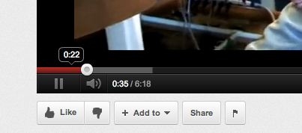
Playback buffers
Playing
here
Buffered
to here
Playback
buffer
From: youtube.com
Notes:
You’ve all seen a playback buffer before. This is a screenshot from a YouTube client. The red line on the left shows how much of the video we’ve watched so far. The dot shows where we’ve got to so far, and the grey area shows how much of the video the client has received but hasn’t played back yet. The client deliberately tries to get ahead just in case some of the packets are delayed and don’t arrive in time, or in case there is a temporary outage. When designing a playback buffer we have to think about how far ahead we want to buffer, and how much we want to accumulate in the buffer before we start playing back the video to the user. Let’s take a closer look…

Slide 4


Playback buffers
1Mb/s
Server
Received by Laptop
Cumulative
Bytes
1Mb/s
1Mb/s
Sent by Server
Playback rate
Variable delay
Buffer
Time
Notes:
Imagine we are watching a YouTube video on the laptop on the right. In our example, the video is being streamed at 1Mb/s from the server on the left, and passes through several routers along the path.
The graph shows the cumulative number of byte sent by the server. Because the server is sending at a constant 1Mb/s, the gradient is 1Mb/s. i.e. after 1s it has sent 1Mbits of data, and after 10seconds it has sent 10Mbits.
Because fo the variable queueing delay in the network, the cumulative arrivals at the laptop might look like this. The biggest component of the delay is the propagation and packetization delay; the variable part of the delay is the queueing delay in the packet buffers. The actual shape of the arrival graph could look very different from this, I just made up this shape. However, we do know a couple of things about it. First, the overall end to end delay can’t be less than the packetization and propagation delay – it has a lower bound. It also has an upper bound: The queueing delay can’t be larger than the sum of all the queueing delays in the routers along the path. Because the routers have finite buffers, and because they serve the packets in FIFO order, there is a maximum delay. Unfortunately, this delay could be huge – the buffers often delay packets by half a second or more. We also know that the cumulative arrivals are non-decreasing – the value can only increase. And finally, the instantaneous arrival rate can’t exceeed the speed of the last link.
OK, with all those caveats, let’s look at what the client needs to do.
This red line shows the rate at which the client needs to playback the video to the user – it’s exactly the same as the rate sent by the server, 1Mb/s. The client needs to BUFFER up enough bytes of data, so that it never goes empty. We say that if the playback buffer goes empty it under-runs. It means the user has no more video and the screen has to freeze. Something we’ve all seen before. In my example here, the buffer never goes empty and the video is fine.

Slide 5
Playback buffers
1Mb/s
Server
Playback buffer
Video
decoder
Screen
Playback
point
Notes:
If we look inside the client we can see the playback buffer and the place it has got to in the video. This is the big dot on the YouTube video client. After the data leaves the playback buffer it goes into the video decoder and placed on the screen.

Slide 6
If the buffer is too small
1Mb/s
Server
Received by Laptop
Cumulative
Bytes
1Mb/s
Sent by Server
Make the buffer bigger!
1Mb/s
Variable delay
Buffer
“Rebuffering”
Time
Notes:
If we make the buffer too small, or start playing back the video too soon, then the playback buffer goes empty and the screen freezes. We have to pause, build up the buffer again, then resume playing out the video at 1Mb/s again. This is often called a Rebuffering Event, and can be pretty annoying. If you’re watching this video over a slow link, or from a long way away you migth experience a rebuffering event. You can fix the problem by streaming at a slower rate, or by downloading the video ahead of time.

Slide 7
Playback buffer
With packet switching, end-to-end delay is variable.
We use a playback buffer to absorb the variation.
We could just make the playback buffer very big, but then the video would be delayed at the start.
Therefore, applications estimate the delay, set the playback buffer, and resize the buffer if the delay changes.

Slide 8
Data
H
Other packets
A
l₁, r₁
l₂, r₂
l₃, r₃
l₄, r₄
B
S1
S2
Q₂(t)
S3
A
p/r₁
p/r₂
S1
l₁/c
Q₂(t)
p/r₃
S2
l₂/c
p/r₄
S3
Queueing adds variable and unpredictable delay
l₃/c
B
l₄/c
time

Slide 9
Summary
Real-time applications use playback buffers to absorb the variation in queueing delay.
Notes:
<Read from slide>
This is the end of the video on end to end delay. I’ll see you again in the next video when I tell you about playback buffers. Packet Switching 3, where I’m going to tell you about a simple deterministic model for understanding variable packet delay.

Slide 10
<end>

Slide 11
<Got to here so far….>
Coming up:
Simple deterministic model of a queue
Some basic results about queues: Little’s result, determinism minimizes delay
Simple model of queue delay (1/mu-lambda)
Leads into next topics:
How to size a playback buffer. (include short demo)
Retransmissions, flow-control, cong control and TCP (3-4 videos)
How to size a router buffer
Per-flow queues, fairness, fair queueing, b/w guarantees
Delay guarantess (generalized processor sharing, Parekh/Gallager).

Slide 12
Queueing*
<
*Queueing = UK spelling, adopted by Kleinrock in 1960s. Queueing and queuing (US spelling) are both widely used.

Slide 13
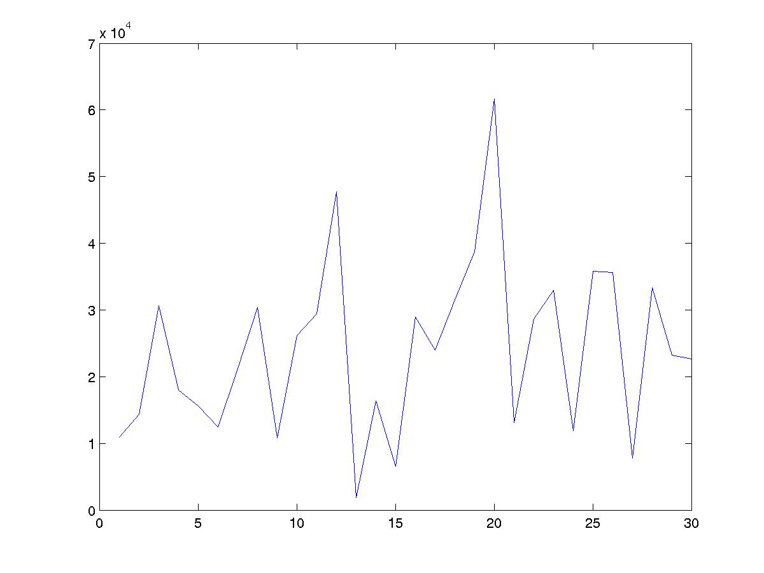
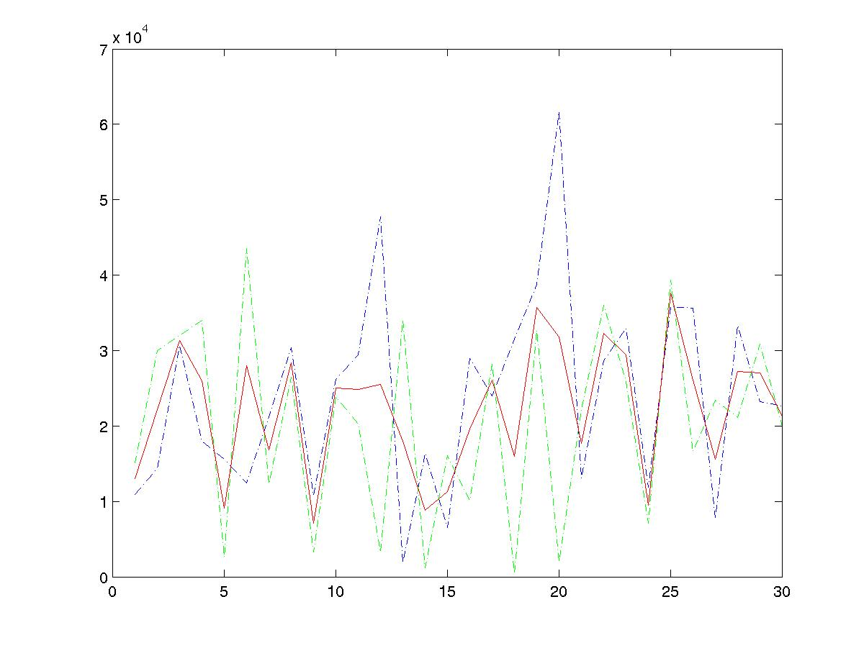
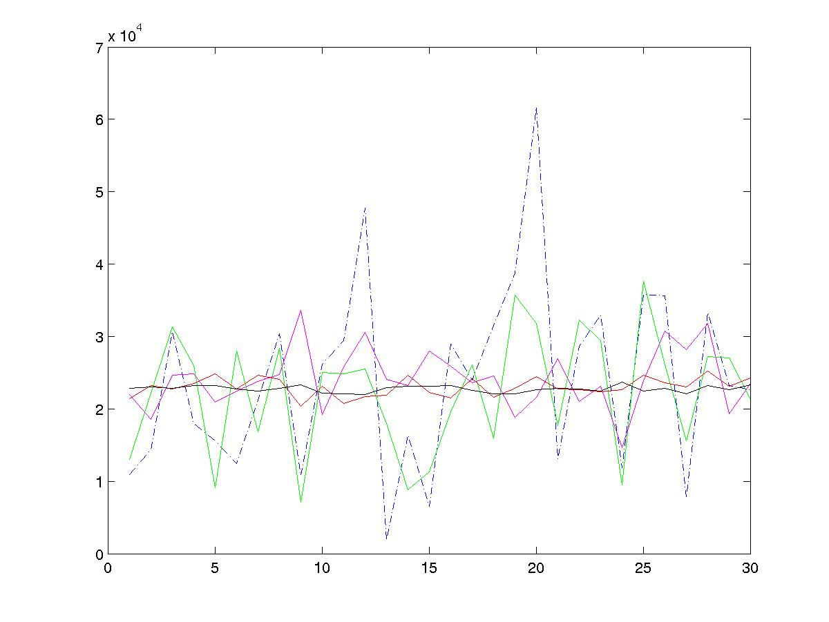
Statistical Multiplexing Basic idea
One flow
Two flows
rate
rate
Average rate
time
Many flows
time
Network traffic is bursty. i.e. the rate changes frequently.
Peaks from independent flows generally occur at different times.
Conclusion: The more flows we have, the smoother the traffic.
rate
Average rates of: 1, 2, 10, 100, 1000 flows.
time

Slide 14
Packet Switching Statistical Multiplexing
Packets for one output
Queue Length
X(t)
Dropped packets
Dropped packets
1
Data
Hdr
R
X(t)
B
2
Data
Hdr
R
Link rate, R
R
Packet buffer
N
Data
Hdr
Time
Because the buffer absorbs temporary bursts, the egress link need not operate at rate N.R.
But the buffer has finite size, B, so losses will occur.

Slide 15
Statistical Multiplexing
Rate
A
C
A
C
time
Rate
B
C
B
C
time
Notes:
Statistical multiplexing
Important if traffic is bursty
Less expensive
Contention requires buffering
Variable delay => no QoS guarantees

Slide 16
Statistical Multiplexing Gain
A+B
Rate
2C
R < 2C
A
R
B
time
Statistical multiplexing gain = 2C/R
Other definitions of SMG: The ratio of rates that give rise to a particular queue occupancy, or particular loss probability.
Notes:
Statistical multiplexing
Important if traffic is bursty
Less expensive
Contention requires buffering
Variable delay => no QoS guarantees

Slide 17
Packet Switching Why not send the entire message in one packet?
M/R
M/R
Host A
Host A
R1
R1
R2
R2
R3
R3
Host B
Host B
Breaking message into packets allows parallel transmission across all links, reducing end to end latency. It also prevents a link from being “hogged” for a long time by one message.

Slide 18
Packet Switching Queueing Delay
Because the egress link is not necessarily free when a packet arrives, it may be queued in a buffer. If the network is busy, packets might have to wait a long time.
Host A
TRANSP1
Q2
R1
TRANSP2
How can we determine the queueing delay?
PROP1
TRANSP3
R2
PROP2
TRANSP4
R3
PROP3
Host B
PROP4

Slide 19
Queues and Queueing Delay
To understand the performance of a packet switched network, we can think of it as a series of queues interconnected by links.
For given link rates and lengths, the only variable is the queueing delay.
If we can understand the queueing delay, we can understand how the network performs.

Slide 20
Queues and Queueing Delay
Cross traffic causes congestion and variable queueing delay.

Slide 21
A router queue
Model of FIFO router queue
A(t), λ
μ
D(t)
Q(t)

Slide 22
A simple deterministic model
Model of FIFO router queue
A(t), λ
μ
D(t)
Q(t)
Properties of A(t), D(t):
A(t), D(t) are non-decreasing
A(t) >= D(t)

Slide 23
A simple deterministic model bytes or “fluid”
Cumulative number of bits that arrived up until time t.
A(t)
A(t)
Cumulative
number of bits
D(t)
Q(t)
μ
Service
process
μ
time
D(t)
Properties of A(t), D(t):
A(t), D(t) are non-decreasing
A(t) >= D(t)
Cumulative number of departed bits up until time t.

Slide 24
Simple deterministic model
Cumulative
number of bits
d(t)
A(t)
Q(t)
D(t)
time
Queue occupancy: Q(t) = A(t) - D(t).
Queueing delay, d(t), is the time spent in the queue by a bit that arrived at time t, and if the queue is served first-come-first-served (FCFS or FIFO)

Slide 25
Example
Cumulative
number of bits
Q(t)
Example: Every second, a train of 100 bits arrive at rate 1000b/s. The maximum departure rate is 500b/s. What is the average queue occupancy?
d(t)
A(t)
100
D(t)
0.1s
0.2s
1.0s
time

Slide 26
Queues with Random Arrival Processes
Usually, arrival processes are complicated, so we often model them as random processes.
The study of queues with random arrival processes is called Queueing Theory.
Queues with random arrival processes have some interesting properties. We’ll consider some here.

Slide 27
Properties of queues
Time evolution of queues.
Examples
Burstiness increases delay
Determinism minimizes delay
Little’s Result.
The M/M/1 queue.

Slide 28
Time evolution of a queue Packets
Model of FIFO router queue
A(t), λ
μ
D(t)
Q(t)
Packet
Arrivals:
Departures:
time
Q(t)

Slide 29
Burstiness increases delay
Example 1: Periodic arrivals
1 packet arrives every 1 second
1 packet can depart every 1 second
Depending on when we sample the queue, it will contain 0 or 1 packets.
Example 2:
N packets arrive together every N seconds (same rate)
1 packet departs every second
Queue might contain 0,1, …, N packets.
Both the average queue occupancy and the variance have increased.
In general, burstiness increases queue occupancy (which increases queueing delay).

Slide 30
Determinism minimizes delay
Example 3: Random arrivals
Packets arrive randomly; on average, 1 packet arrives per second.
Exactly 1 packet can depart every 1 second.
Depending on when we sample the queue, it will contain 0, 1, 2, … packets depending on the distribution of the arrivals.
In general, determinism minimizes delay. i.e. random arrival processes lead to larger delay than simple periodic arrival processes.

Slide 31
Little’s Result

Slide 32
The Poisson process

Slide 33
The Poisson process
Why use the Poisson process?
It is the continuous time equivalent of a series of coin tosses.
The Poisson process is known to model well systems in which a large number of independent events are aggregated together. e.g.
Arrival of new phone calls to a telephone switch
Decay of nuclear particles
“Shot noise” in an electrical circuit
It makes the math easy.
Be warned
Network traffic is very bursty!
Packet arrivals are not Poisson.
But it models quite well the arrival of new flows.

Slide 34
An M/M/1 queue
Model of FIFO router queue
A(t), λ
μ
D(t)
If A(t) is a Poisson process with rate λ, and the time to serve each packet is exponentially distributed with rate μ, then:

